Slide 1


Reddit
r/AnalyzingRedditComments

Slide 2
r/DataProblems
The following points summarize the main dataset problems
Controversiality is zero for all comments
All comments have zero downvotes
Controversiality can not be inferred since all downs are zeros
Some comments have their body deleted
Comments only receive 0 or 1 golds, making “gilded” property useless in any analysis

Slide 3
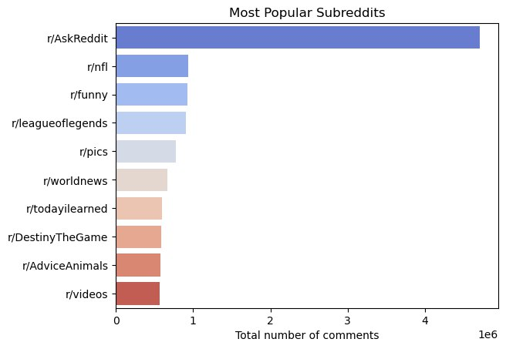
r/TopSubreddits

Slide 4
r/TopSubreddits
AskReddit seems to be by far the most popular subreddit.
In general, most popular subreddits are those where users can get ask questions or know more information about something such as:
AskReddit
AdviceAnimals
todayilearned
worldnews

Slide 5
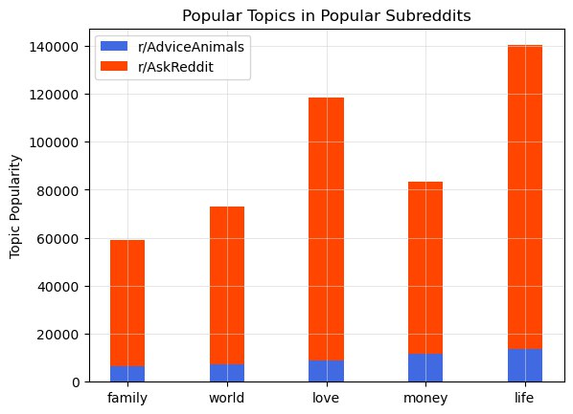
r/PopularTopics
Users in top subreddits seem to be talking a lot about life, love, and money

Slide 6
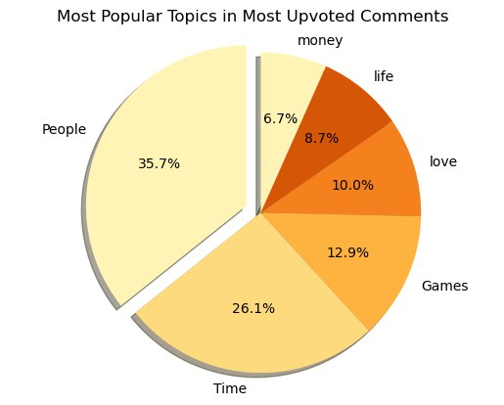
r/TopUpvotedTopcis
Again love, life, and money do appear in the most upvoted comments but not on top of the list, because people are not necessarily content about their lives, money, love and relationships.

Slide 7
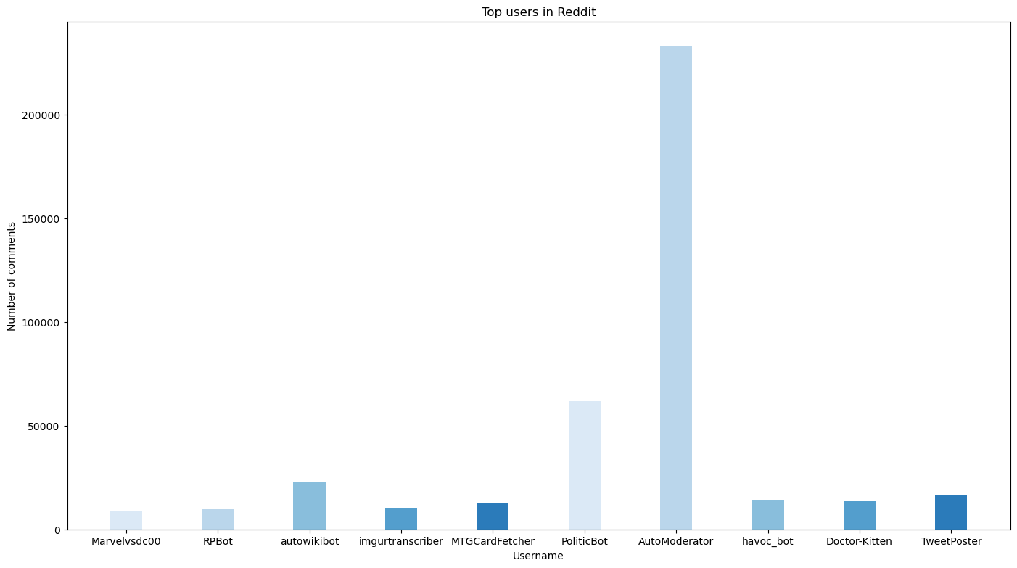
rTopUsers

Slide 8
r/TopUsers
It appears that a lot of the top users are not humans, they are actually bots!
This is a problem when trying to track most active users in a certain subreddit, because the dataset doesn’t state which user is actually a bot.
Inferring a bot from the username is also not a solution since a human user can have a username containing the word “bot”.

Slide 9
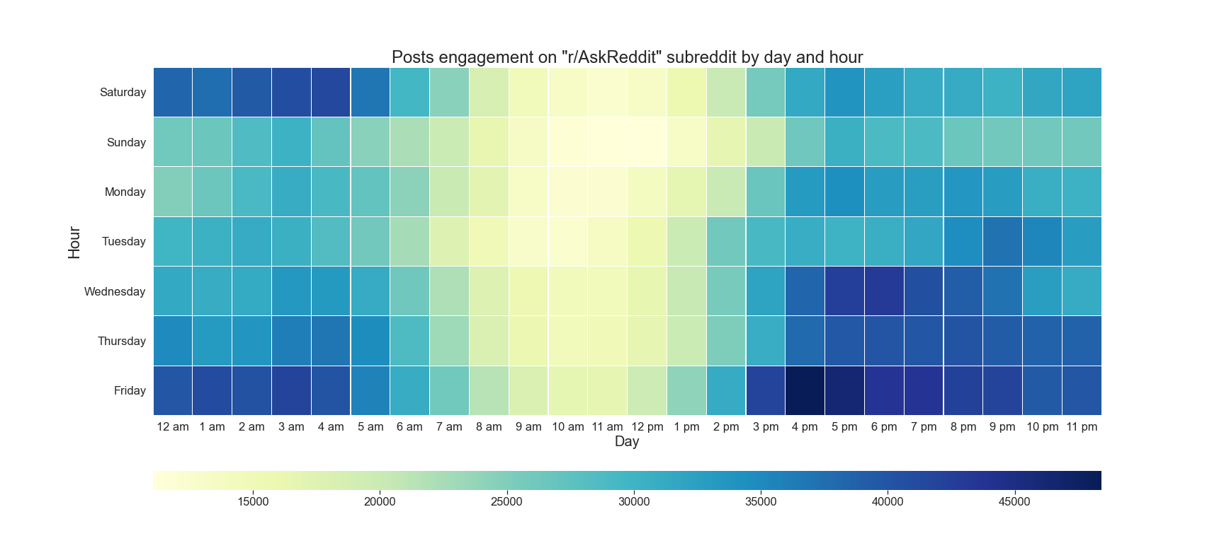
r/MaximizePostReach

Slide 10
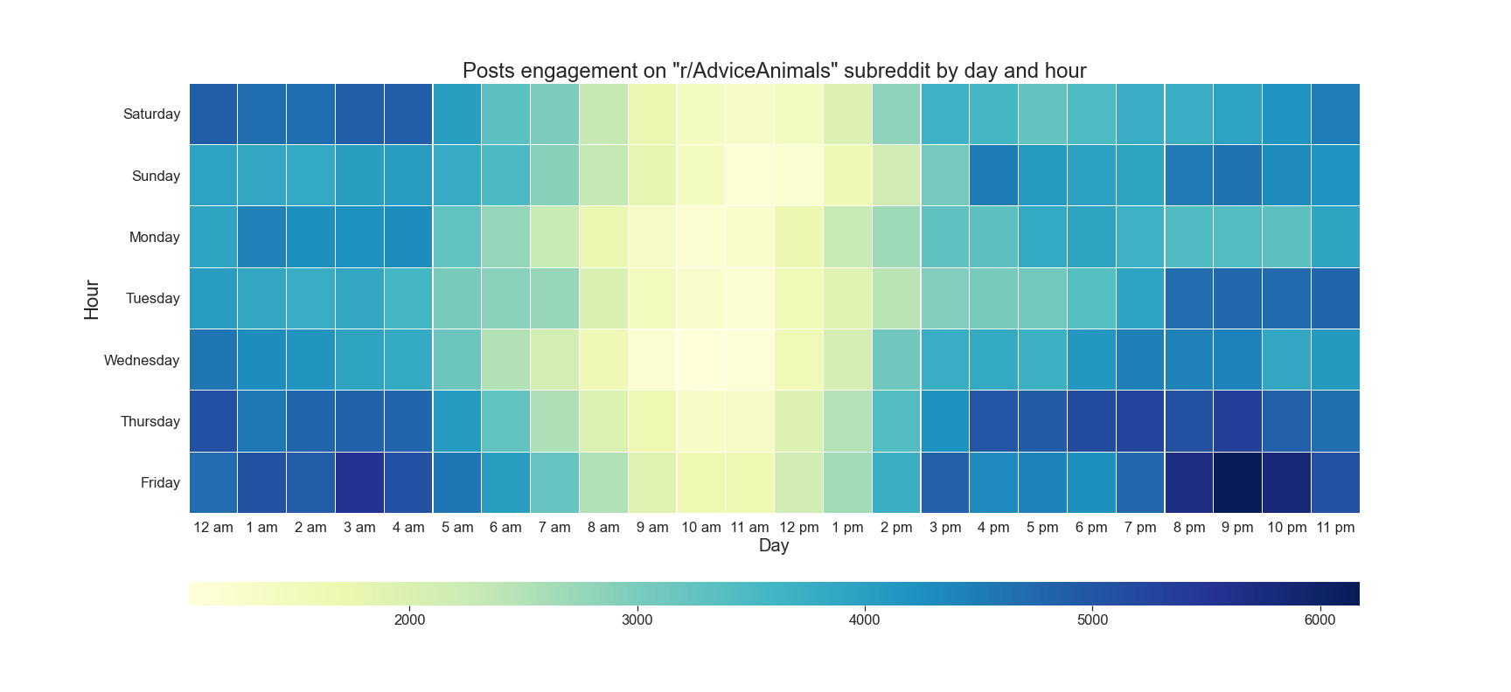
r/MaximizePostReach

Slide 11
r/MaximizePostReach
Depending on the subreddit you can maximize the post reach by choosing the best time to post:
r/AskReddit: users are most active on Fridays at 4 PM
r/AdviceAnimals: users are most active on Fridays at 9 PM

